Slide 1
Basic Auth Deprecation in Exchange Online
Greg Taylor
Product Manager / M365 Core
grtaylor@microsoft.com / gregtaylor_msft

Slide 2

Today
Timeline and scope reminder
Where to look for data
Top Tips
Useful Links

Slide 3
Timeline and Scope
Beginning October 1st 2022, we will start to turn off Basic Auth for the following protocols:
POP, IMAP
EWS, MAPI, RPC, OAB (Outlook)
Exchange ActiveSync (EAS)
Exchange Online Remote PowerShell
We’re not turning off the protocols – just the ability to use basic auth with them. They all support modern auth already
Before October we might temporarily interrupt service on any/all – opt out by following the steps here
If we have turned something off, prior to Oct 1st, you can re-enable it quickly following the steps here or linked to in the SHD and MC posts
We will not turn off SMTP AUTH if it being used – and if we do turn it off, you can turn it back on again - indefinitely

Slide 4
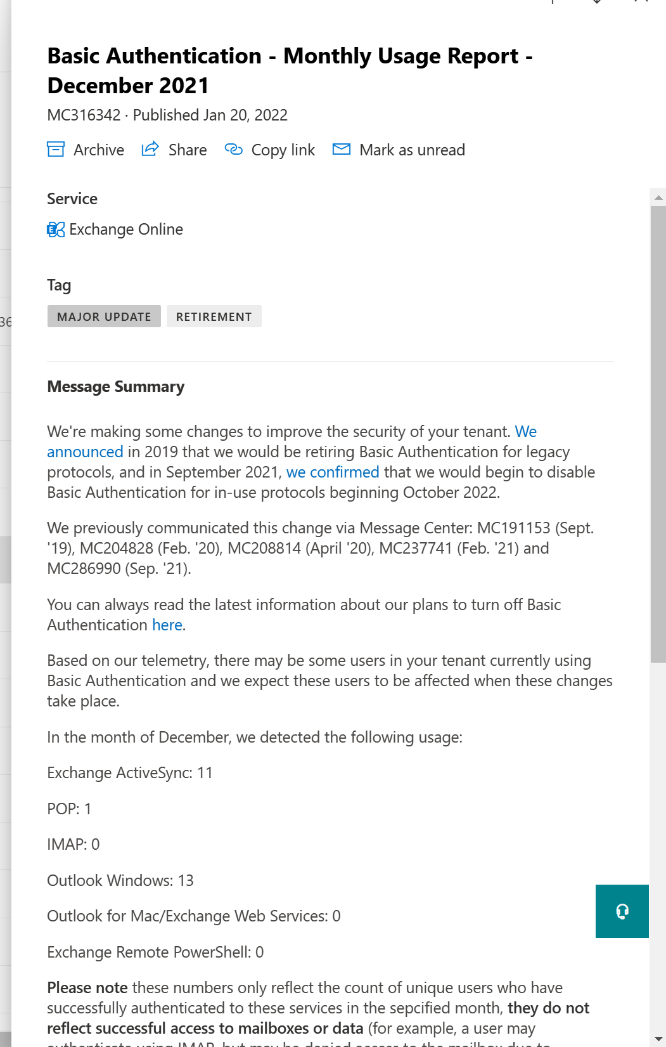
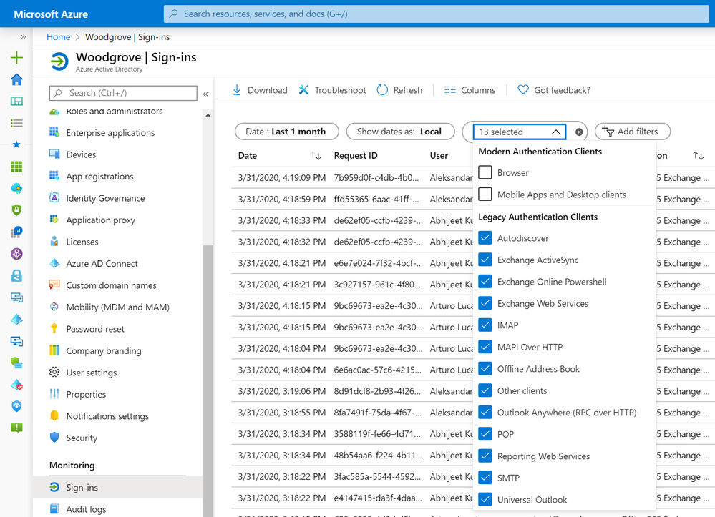
Where to Find Usage Data
Message Center
We send monthly MC posts with usage summaries to the tenants using basic auth
Azure AD Sign In Reports
All the detail you can ask for (and more)
Large customers please review tips here

Slide 5
Top Tips When Looking At Usage Data
ActiveSync (EAS)
If you have an MDM – use it to push new profiles!
Without MDM, the most solution in many native apps is to remove, then add back the mail account
Cert based auth is not basic auth – CBA for EAS will not be impacted by this change
Outlook for Windows (MAPI, RPC, EWS and OAB)
Check Get-OrganizationConfig –OAuth2ClientProfileEnabled
False will prevent Outlook for Windows from connecting
In Azure AD Sign In Logs look for the User Agent String in EWS
Example: Microsoft Office/15.0 (Windows NT 6.1; Microsoft Outlook 15.0.4893; Pro)
14.0 – Outlook 2010 – it cannot do Modern Auth, it must be upgraded
15.0 – Outlook 2013 – it can do Modern Auth, but needs the EnableADAL reg key setting
16.0 – Outlook 2016+ - it does Modern Auth by default, no changes needed
If you see 16.0 anywhere – there’s a policy in place setting the EnableADAL key to 0

Slide 6
More Top Tips
Exchange Web Services (EWS)
Mac Mail and Mac Outlook User Agent Strings
AppleExchangeWebServices/814.100.1 Mail/3654.120.0.1.13
MacOutlook/16.55.21111400 (Intelx64 Mac OS X 12.0.1 (Build 21A559))
Scripts / Apps
python-requests/2.26.0
ExchangeServicesClient/15.00.0913.015 (Windows Surface Hubs – will be fixed by future update)
Spark/2.11.9.504 CFNetwork/1325.0.1 Darwin/21.1.0
MicrosoftTeamsRoom - Teams Rooms
Etc.
MDM
AirWatch Boxer (SM-G998U; Android 12) Version 21.11.0.2/2435
EWS is used by many apps, so User Agents, user/mailbox, and IP addresses are going to help identify them
Path forward is move to EWS with OAuth, or Microsoft Graph
POP/IMAP/RPS – there are no user agent strings, just user details and source IP
POP/IMAP – can do OAuth already – Client Credential Flow coming very soon
A lot of LOB apps use POP/IMAP to poll mailboxes – get working on those asap
RPS – Use EXO V2 module and read this article

Slide 7
Next Steps
Look at the summary data sent to your Message Center to get an idea of where to focus
Use Azure AD Sign in reports, filtering by protocol, to see user account, user agent, IP address details etc. (export to JSON, not csv)
Prepare some kind of end-user communication if you need users to do something. Here’s a great example from the University of Wisconsin
Upgrade old versions of Office, Check the EnableADAL key is set
Speak to your MDM expert/vendor, roll out new profiles with updated auth
Start talking to third party app providers now, app dev and deployment takes time
It could be a good time to stop POP and IMAP and switch those users to OWA
Complete the opt-out if you want us to leave any protocols alone for as long as possible

Slide 8
Useful Links
Deprecation of Basic authentication in Exchange Online | Microsoft Docs
Basic Authentication and Exchange Online – September 2021 Update - Microsoft Tech Community
How modern authentication works for Office 2013 and Office 2016 client apps - Microsoft 365 Enterprise | Microsoft Docs
Enabling Modern Auth for Outlook – How Hard Can It Be? - Microsoft Tech Community
About the Exchange Online PowerShell V2 module | Microsoft Docs
Connect to Security & Compliance Center PowerShell using the EXO V2 module | Microsoft Docs
Exchange Online and Exchange development | Microsoft Docs
Authentication and EWS in Exchange | Microsoft Docs
Microsoft identity platform and OAuth 2.0 authorization code flow - Microsoft identity platform | Microsoft Docs
MSAL authentication flows - Microsoft identity platform | Microsoft Docs
Glen Scales GitHub sample for EWS OAuth token handling
Authenticate an IMAP, POP or SMTP connection using OAuth | Microsoft Docs

